Slide 1

DIABETES PREDICTION SYSTEM
`
INTERNSHIP AT EXPOSYS DATA LABS
YASHWANT SAIARJUN.S.V
VUTUKURI ESWAR CHAND
YARRAM ABILASH REDDY
KARRI VENKATA NAGA SAI VAMSI
This Photo by Unknown author is licensed under CC BY.

Slide 2
TABLE OF CONTENTS:
S.NO | TOPIC | SLIDE NO.
1 | INTRODUCTION | 3
2 | ABSTRACT | 4
3 | EXISTING METHOD | 5
4 | PROPOSED METHOD WITH ARCHITECTURE | 6
5 | METHOLOGY | 7-10
6 | IMPLEMENTATION | 11-19
7 | CONCLUSION | 20

Slide 3

INTRODUCTION:
Diabetes is a type of chronic disease which is more common among the people of all age groups. Predicting this disease at an early stage can help a person to take the necessary precautions and change his/her lifestyle accordingly to either prevent the occurrences disease or control the disease (For people who already have the disease).
We are training the machine to understand the data given by the user. Here we are preparing several methods to train the model and building the model which can give high accuracy

Slide 4
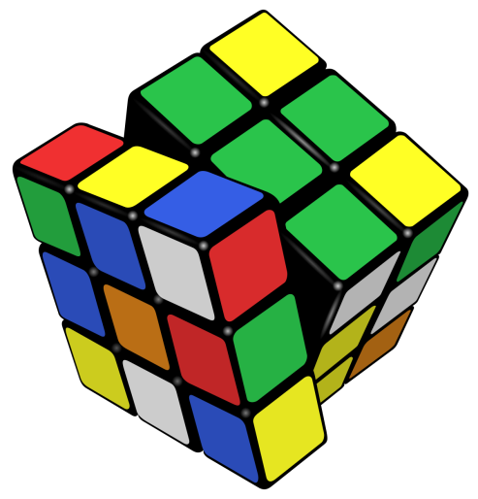
ABSTRACT:
We are creating a model which can give high accuracy of predicting the disease diabetes from the user given data set.
We are using python language to code the model. This project also uses various libraries like pandas(1.2.4) ,numpy(1.20.1) ,sklearn(0.11.1) ,matplotlib(0.11.1) ,seaborn(0.11.1).
We are importing the dataset .Next we are checking for data outliners and performing data cleaning . We plot the data in Pie and Bar charts .We are using RandomForestClassifer model to predict the diabetes disease using test and train values .User gives the required inputs and the model predicts the Diabetic or Non-Diabetic person.

Slide 5
EXISTING METHOD:
This project is developed using the SDLC method Waterfall Model . Since all the requirements are available accurately . Waterfall Model can fetch the perfect result for making this model. We complete the model using 5 phases namely
Collection
Cleaning
Exploratory Data Analysis
Model Building
Model Deployment

Slide 6
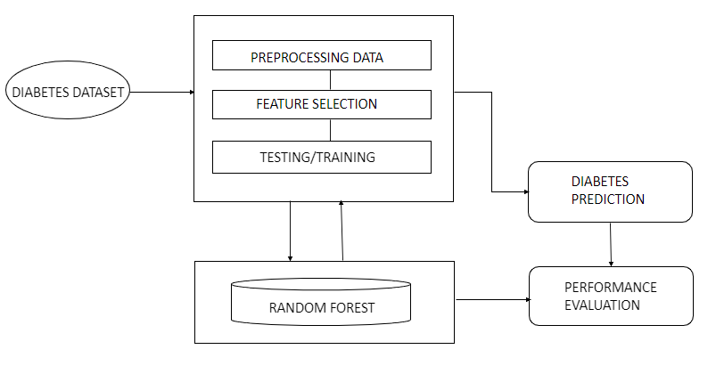
PROPOSED METHOD WITH ARCHITECTURE:

Slide 7
METHODOLGY:
With the use of waterfall model to implement the project.
1.COLLECTION
2.CLEANING
3.EXPLORATORY DATA ANALYSIS
4.MODEL BUILDING
5.MODEL DEPLOYMENT

Slide 8
1.COLLECTION:
The basic requirements needed are collected here
Age
Gender
Number of Pregnancies
BMI(Body Mass index)
Glucose Level
Insulin Level
BP Level
Skin Thickness
Diabetes Prediction Factor
Outcome
A Datasheet of above mentioned details to Train the model and after training the model(Developer end)
User needs to give the mentioned details to verify does he/she is having Diabetes(User end)

Slide 9
2.CLEANING
All the requirements specified in the previous stage are studied here . We are cleaning the data set here . Checking for any null values . Since the mentioned requirements should not be 0 and replace them with mean values. Renaming the column values as user can understand . We described the dataset in pie and bar charts for better understanding.
3.EXPLORATORY DATA ANALYSIS:
We are using RandomForestClassifier model to develop the project . We Test , Train and Split the model . After training the model we predict the accuracy . The accuracy of the model will be around 75% . We get all the user inputs and give the result

Slide 10
4.MODEL BULIDING:
All the 5 units specified in the previous phase are combined into a whole code and verify is it working properly . If any of the units doesn’t give desired result we again go to implementation phase and change it . Here we ensure that each and every statement of about to make sure of the better performance of the model . After the Model is built perfectly it is ready for the deployment stage.
5.MODEL DEPLOYMENT:
The concept of deployment in data science refers to the application of a model for prediction using a new data. Building a model is generally not the end of the project. After the installation of the model we make sure that if any changes required by the customer are done . We will be in touch with the customer for any type of future instances .

Slide 11
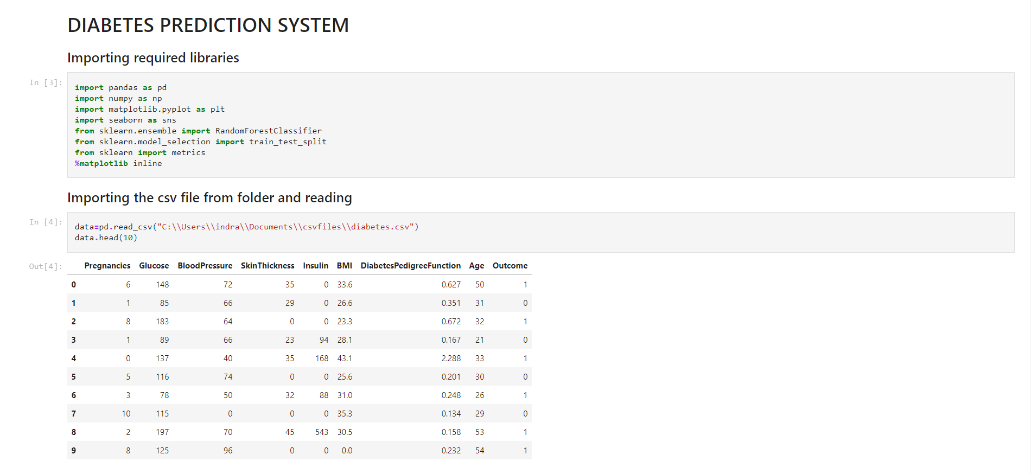
IMPLEMENTATION:
This project is about implementing a model to find if a person is having diabetes using Data Science in Python.

Slide 12
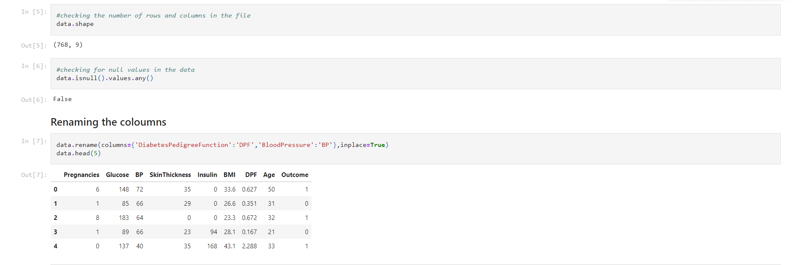
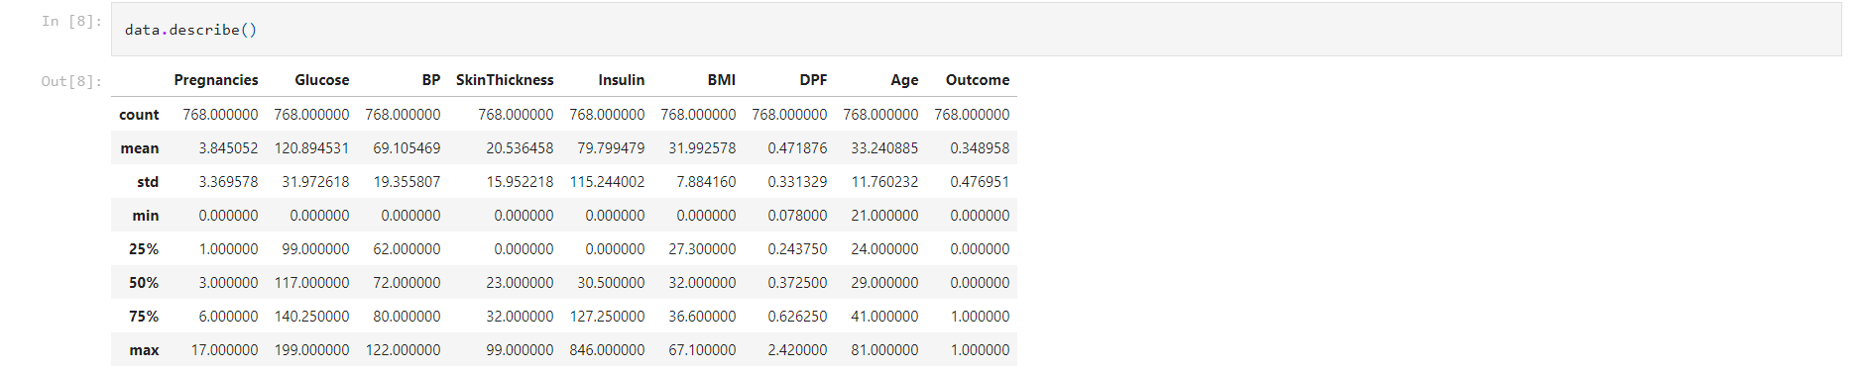

Slide 13
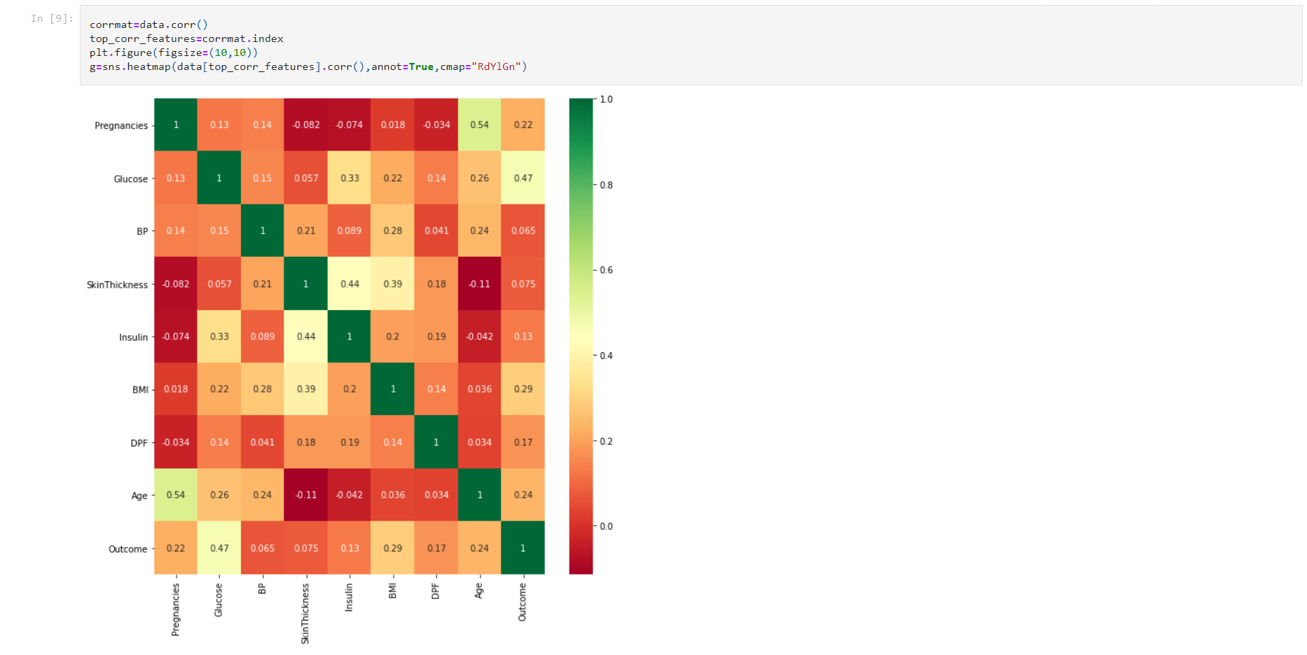

Slide 14
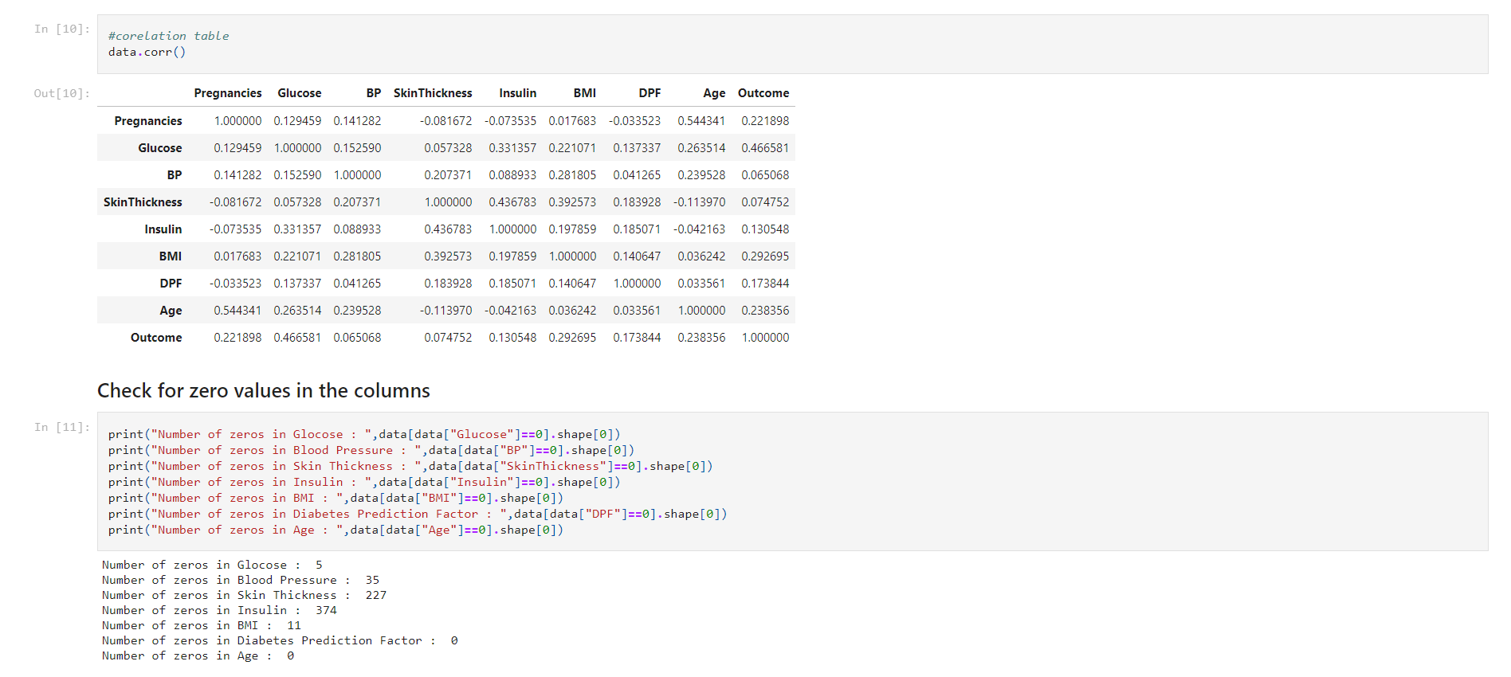

Slide 15
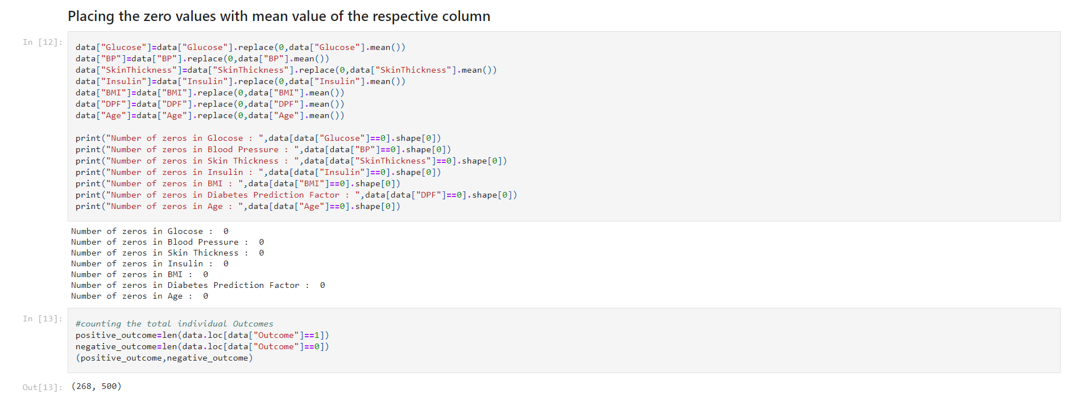

Slide 16
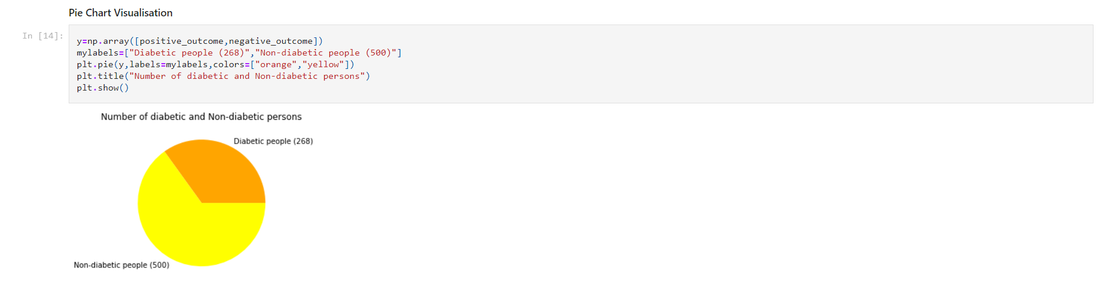
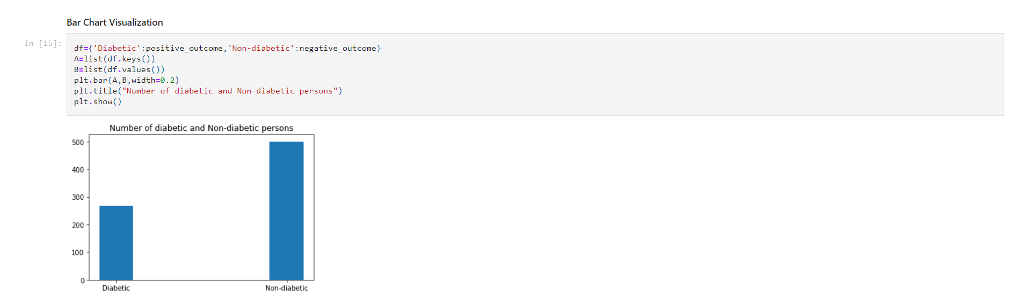

Slide 17
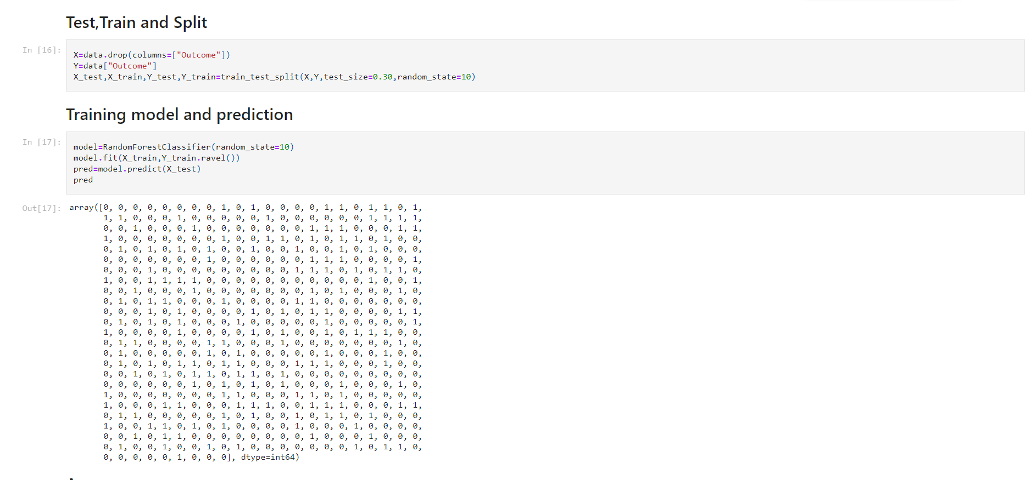

Slide 18
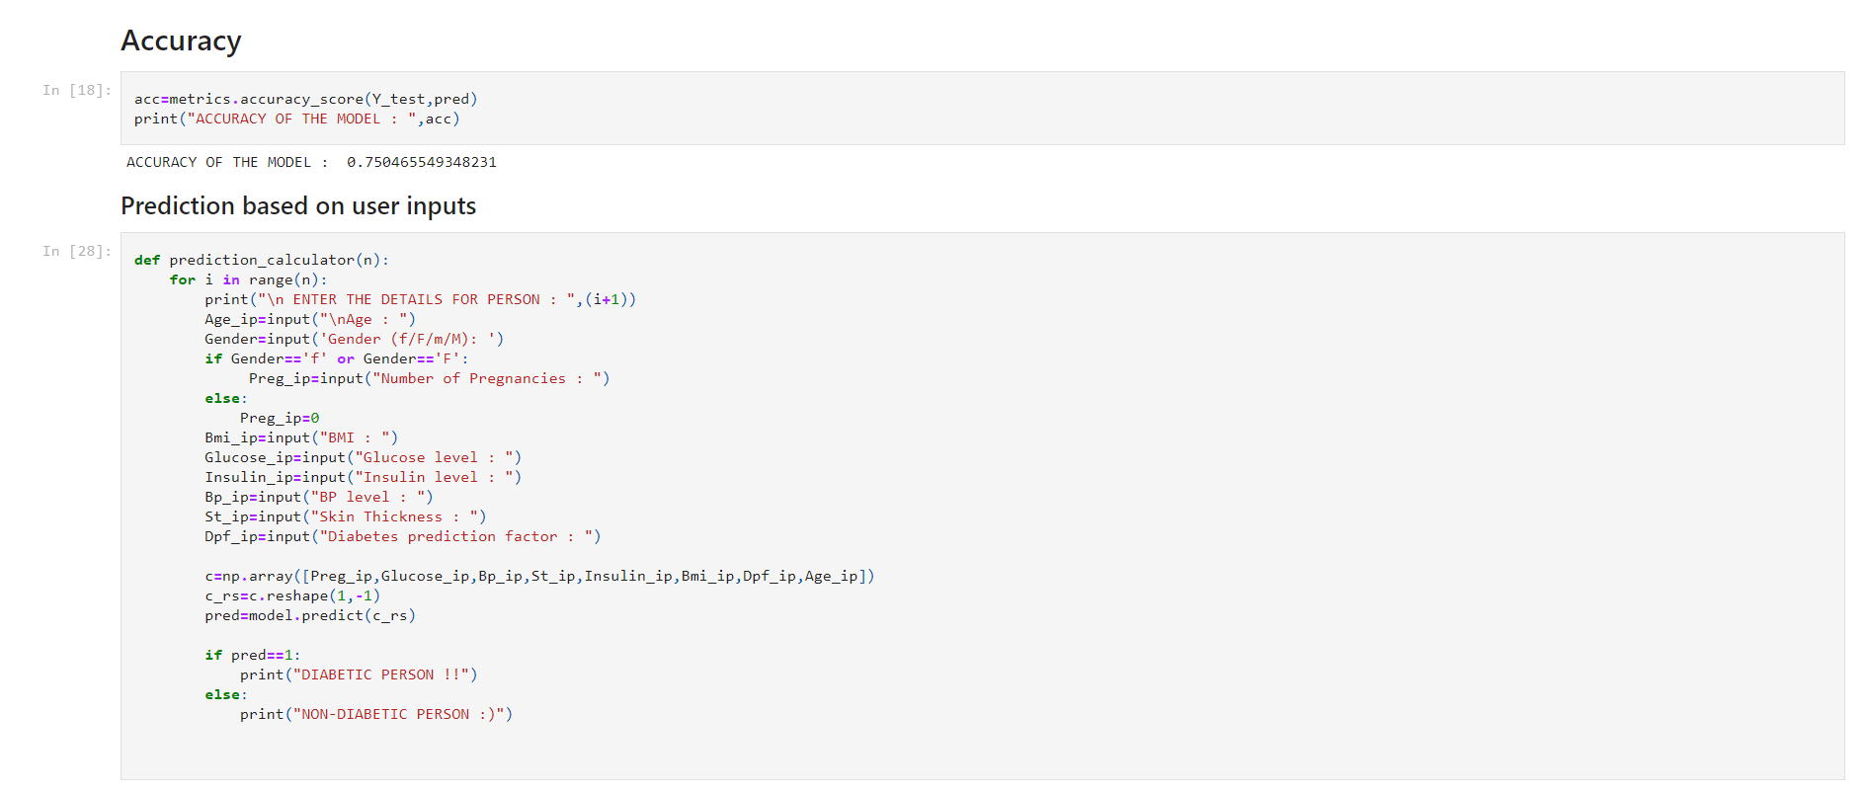

Slide 19
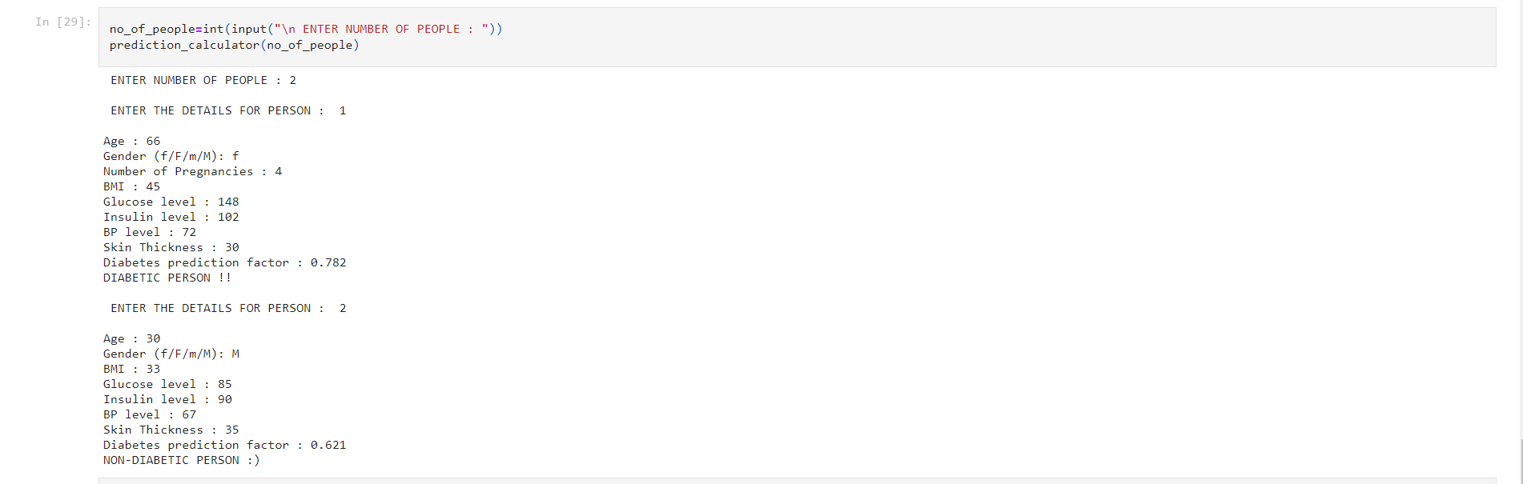

Slide 20
CONCLUSION:
Overall our planning and research went quite well . Our group had some few chats about the project planning . We tried our level best to include all the necessary points required related to the topic . We referred some books and surfed the internet for the better outcome of the project
This is an user friendly source to check whether the user is having diabetes or not with some required inputs from the user .

